Slide 1
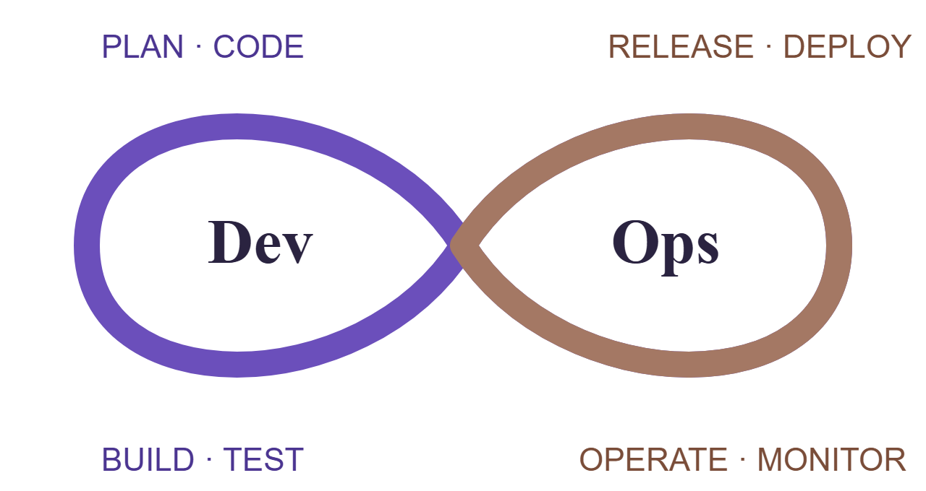
Notes Service
DEVOPS THEORY · CA-2 · BTECH PROJECT
From commit to cluster: a Flask REST service taken through the full DevOps lifecycle
GitHub Actions
Ansible
Docker + Kubernetes
Prometheus + Grafana
[Member 1 name] · [PRN]
[Member 2 name] · [PRN]
[Member 3 name] · [PRN]
Notes:
Introduce the team and the project: a small Flask notes API that we used as the vehicle for every DevOps step in CA-2: pipeline, configuration management, containers and orchestration, and monitoring.

Slide 2
How the pieces connect
NOTES SERVICE · CA-2
Architecture
Pipeline flow
Challenges
Lessons
ARCHITECTURE
KUBERNETES · NS notes
Developer
GITHUB ACTIONS → GHCR
Service · NodePort 30080
→
→
push / PR
Lint
Test
›
Build
›
Scan
›
Deploy
›
Publish
Pod 1
Pod 2
Pod 3
HPA 3–6 · PDB min 2 · ConfigMap
CONFIGURATION · ANSIBLE ROLES
OBSERVABILITY
common + notes_app
⇢
Ubuntu VM · venv · systemd
/metrics
→
Prometheus + alerts
→
Grafana
Flask app endpoints /health · /ready · /version · /notes · /metrics · /boom · /slow
Flask + gunicorn · GitHub Actions · Ansible · Docker · Kubernetes · Prometheus · Grafana
02
Notes:
A push or PR triggers GitHub Actions: lint and test in parallel, build the image once, scan it with Trivy, deploy it to a throwaway kind cluster, then publish the same image to GHCR. In Kubernetes the app runs in the notes namespace: three pods behind a NodePort service, an HPA that scales from 3 to 6, a PodDisruptionBudget that keeps at least 2 up, and settings from a ConfigMap. Ansible roles configure a plain Ubuntu VM with a virtualenv and a systemd unit. Prometheus scrapes /metrics, evaluates alert rules, and Grafana shows the provisioned dashboard.

Slide 3
From commit to monitored cluster
NOTES SERVICE · CA-2
Architecture
Pipeline flow
Challenges
Lessons
PIPELINE FLOW
STEP 1 · CI/CD
STEP 2 · CONFIG
STEP 3 · CONTAINERS
STEP 4 · MONITORING
GitHub Actions
Ansible roles
Docker + K8s
Prometheus + Grafana
Lint: ruff, hadolint, yamllint, ansible-lint, kubeconform
pytest, coverage ≥ 85%
Build once, smoke test
Trivy image + config scan
Deploy to kind, push to GHCR
common: packages, timezone, admin users
notes_app: nologin user, dirs, .env 0600
Deps in a virtualenv
systemd unit + logrotate
Checks /health and /version
Multi-stage, non-root, read-only FS
3 replicas, HPA 3–6, PDB 2
/ready and /health probes
maxSurge 1, maxUnavailable 0
60 s deadline, preStop 5 s
Scrape /metrics every 5 s
Four golden signals
Dashboard provisioned as code
Alerts: down, errors > 5%, p95 > 500 ms
Logs via kubectl logs
Auto-rollback on failure
Re-run: changed=0
Zero-downtime updates
13 panels · 3 alerts
ci.yml · ansible/roles · Dockerfile · k8s/ · monitoring/
03
Notes:
Step 1: lint and test run in parallel; the image is built once as version 1.0.run-number, smoke-tested, scanned with Trivy, deployed to a kind cluster inside the job, and only then pushed to GHCR. If the rollout is not healthy within 120 seconds the job runs rollout undo and fails. Step 2: two Ansible roles configure the host; dependencies go into a virtualenv and the app runs under systemd, and the playbook verifies health and version at the end. Step 3: a multi-stage, non-root image; Kubernetes adds autoscaling, a disruption budget, separate readiness and liveness probes, a progress deadline and a preStop delay so no requests are dropped. Step 4: Prometheus scrapes every 5 seconds, Grafana loads the dashboard from the repo, and three alert rules cover downtime, error rate and latency.

Slide 4
What got in the way, and the fix
NOTES SERVICE · CA-2
Architecture
Pipeline flow
Challenges
Lessons
CHALLENGES
01 apt stalled on a tzdata prompt
02 pip blocked by PEP 668
Installing packages in the Ubuntu test container stopped to ask for a time zone.
Ubuntu 24.04 refuses pip installs into system Python; the first fix was --break-system-packages.
Fix DEBIAN_FRONTEND=noninteractive, and the common role sets the time zone.
Fix Install dependencies into a virtualenv owned by the app user.
03 Metrics jumping up and down
04 Pods stuck in ErrImagePull
Two gunicorn workers each kept their own counters, so Prometheus totals were inconsistent.
The cluster could not see images built on the host machine.
Fix minikube image load / kind load, plus imagePullPolicy: IfNotPresent.
Fix One worker with four threads, so one process owns the metrics.
Also solved: no systemd in test containers · Windows line endings · readiness vs liveness
04
Notes:
The four problems that cost us the most time. Others we solved along the way: testing the playbook in Docker meant there was no systemd, so the role detects the service manager and starts gunicorn as a daemon instead; scripts edited on Windows failed with bad interpreter until .gitattributes forced LF line endings; and using /health for both probes sent traffic to pods that were not ready, so we added a separate /ready endpoint.

Slide 5
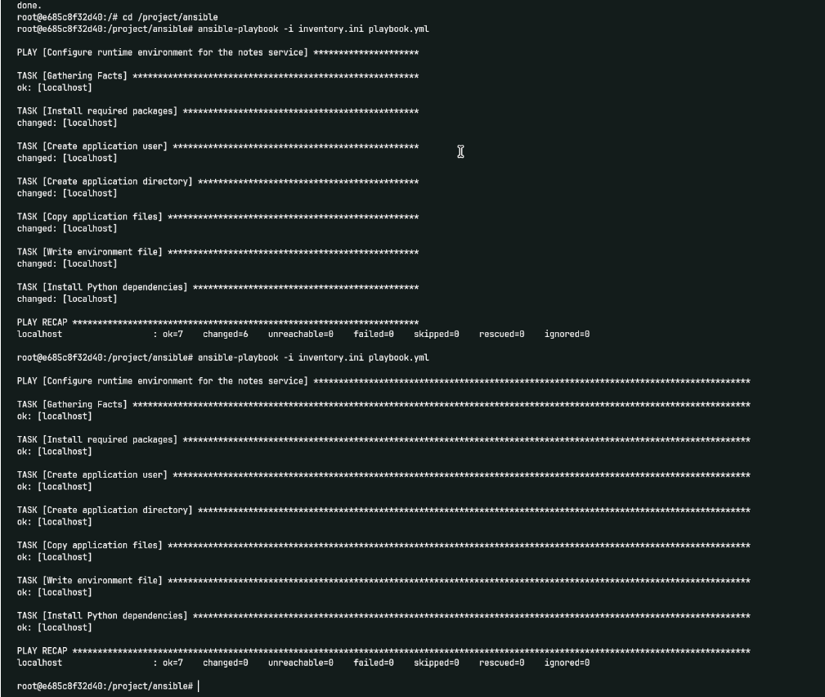
What we would carry forward
NOTES SERVICE · CA-2
Architecture
Pipeline flow
Challenges
Lessons
LESSONS LEARNED
Build once, ship that artefact
The image we test, scan and deploy is the exact one pushed to GHCR.
Idempotency is testable
Running the playbook twice and checking changed=0 exposes non-declarative tasks.
Rollback is a design choice
Probes, maxUnavailable 0 and a progress deadline stop a bad release first.
Everything as code, security early
Pipeline, config, cluster, dashboards and alerts live in the repo; linting and scans run on every push.
Ansible run twice: changed=6, then changed=0
github.com/aditisharmas11/DevOps-CA2_2023_27 · Thank you
05
Notes:
Build once: rebuilding per stage means testing one image and shipping another. Idempotency: the screenshot shows the second run changed nothing. Rollback: rollout undo only helps if probes, maxUnavailable 0 and a progress deadline keep the old pods serving while the bad release stalls. Everything as code: the pipeline, server config, cluster state, dashboards and alerts are all reviewed files, and linting, image scanning and a non-root, read-only container cost almost nothing to add early. Thank the audience and point to the repository.

